Slide 1
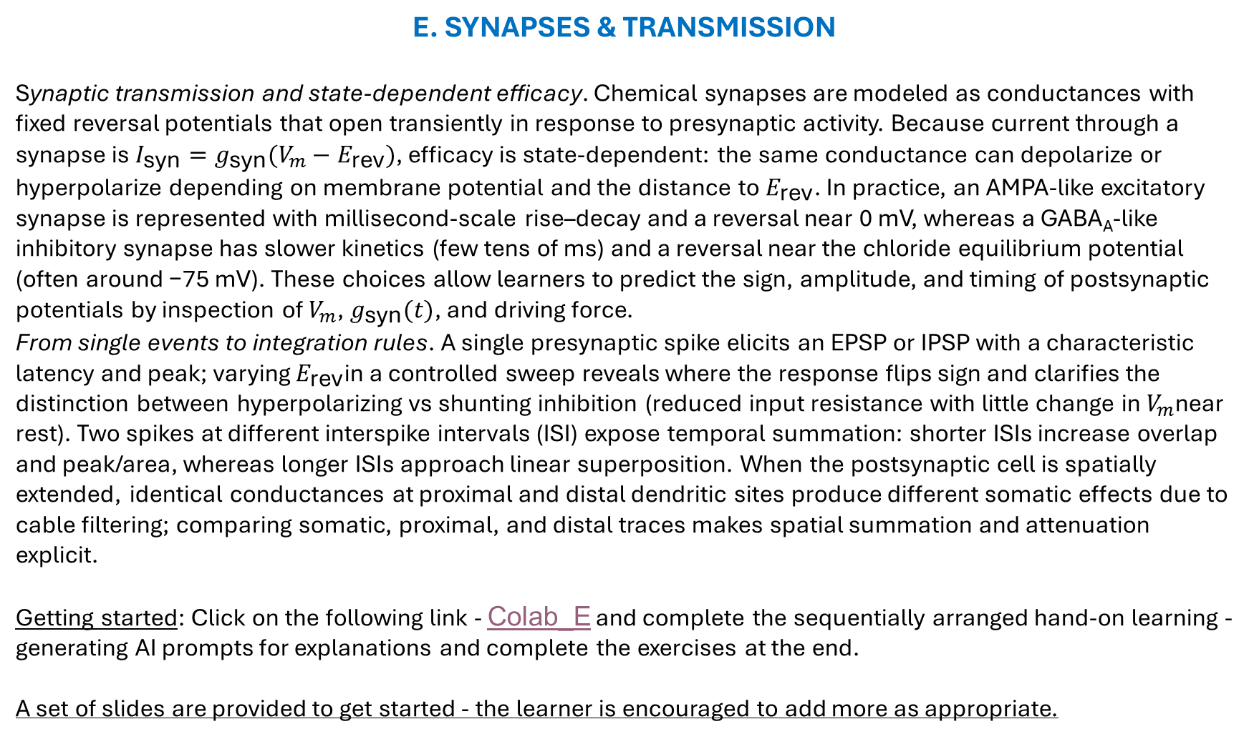
E. SYNAPSES & TRANSMISSION
Synaptic transmission and state‑dependent efficacy. Chemical synapses are modeled as conductances with fixed reversal potentials that open transiently in response to presynaptic activity. Because current through a synapse is $I_{\text{syn}}=g_{\text{syn}}(V_{m}−E_{\text{rev}})$, efficacy is state‑dependent: the same conductance can depolarize or hyperpolarize depending on membrane potential and the distance to $E_{\text{rev}}$. In practice, an AMPA‑like excitatory synapse is represented with millisecond‑scale rise–decay and a reversal near 0 mV, whereas a GABA_{A}‑like inhibitory synapse has slower kinetics (few tens of ms) and a reversal near the chloride equilibrium potential (often around −75 mV). These choices allow learners to predict the sign, amplitude, and timing of postsynaptic potentials by inspection of $V_{m}$, $g_{\text{syn}}(t)$, and driving force.
From single events to integration rules. A single presynaptic spike elicits an EPSP or IPSP with a characteristic latency and peak; varying $E_{\text{rev}}$in a controlled sweep reveals where the response flips sign and clarifies the distinction between hyperpolarizing vs shunting inhibition (reduced input resistance with little change in $V_{m}$near rest). Two spikes at different interspike intervals (ISI) expose temporal summation: shorter ISIs increase overlap and peak/area, whereas longer ISIs approach linear superposition. When the postsynaptic cell is spatially extended, identical conductances at proximal and distal dendritic sites produce different somatic effects due to cable filtering; comparing somatic, proximal, and distal traces makes spatial summation and attenuation explicit.
Getting started: Click on the following link - Colab_E and complete the sequentially arranged hand-on learning - generating AI prompts for explanations and complete the exercises at the end.
A set of slides are provided to get started - the learner is encouraged to add more as appropriate.

Slide 2
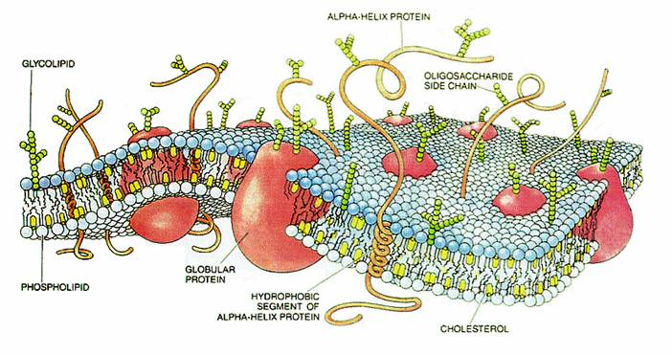
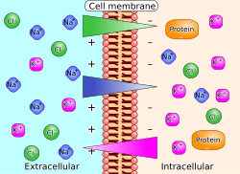
Now we connect to systems concepts: RC membrane, conductances, Nernst/Goldman, pumps as rechargers, τ, λ, HH intuition.
Colab for part B - https://colab.research.google.com/github/cyneuro/Chapter_Colabs/blob/main/Colab_B.ipynb
B1. Membrane as Capacitor + Leak as Resistor The bilayer stores charge (capacitance), while leak
channels provide conductive paths.
Together they produce RC‑like voltage time courses.
Self‑learning prompt: Using everyday analogies, explain why
membranes have capacitance and how leak affects voltage
over time. Predict the qualitative shape of V(t) to a small
current step.
B2. Ion Gradients as Batteries — Nernst Potentials
Each ion’s gradient corresponds to a reversal potential
via Nernst. Channel selectivity ties ion flow to driving force
Self‑learning prompt: Compute E_K and E_Na from given
concentrations. Explain how changing internal K⁺ or external
Na⁺ shifts the corresponding Nernst potentials.

Slide 3
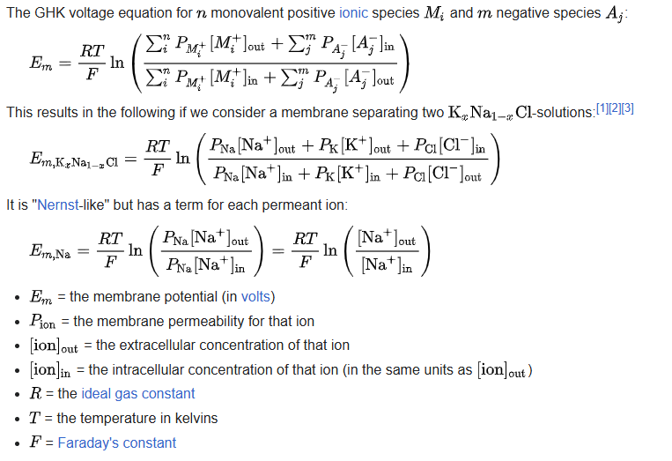
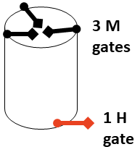
B3. Multiple Ions — Goldman–Hodgkin–Katz (GHK) and Resting Potential
With several permeant ions, resting V depends on relative permeabilities (P_K, P_Na, P_Cl), not just concentrations.
Self‑learning prompt:
Explain how changing
P_K/P_Na moves the
resting potential.
Provide a qualitative
graph showing resting
V as P_K increases.
B4. Voltage‑Gated Channels — Activation & Inactivation (m, h, n) Na⁺ channels: activation (m) and inactivation (h); K⁺: activation (n). Their voltage dependence creates spikes via positive and negative
feedback loops.
Self‑learning prompt: Describe how m, h, and n change with depolarization and how that sequence produces an action potential’s rise and fall.

Slide 4
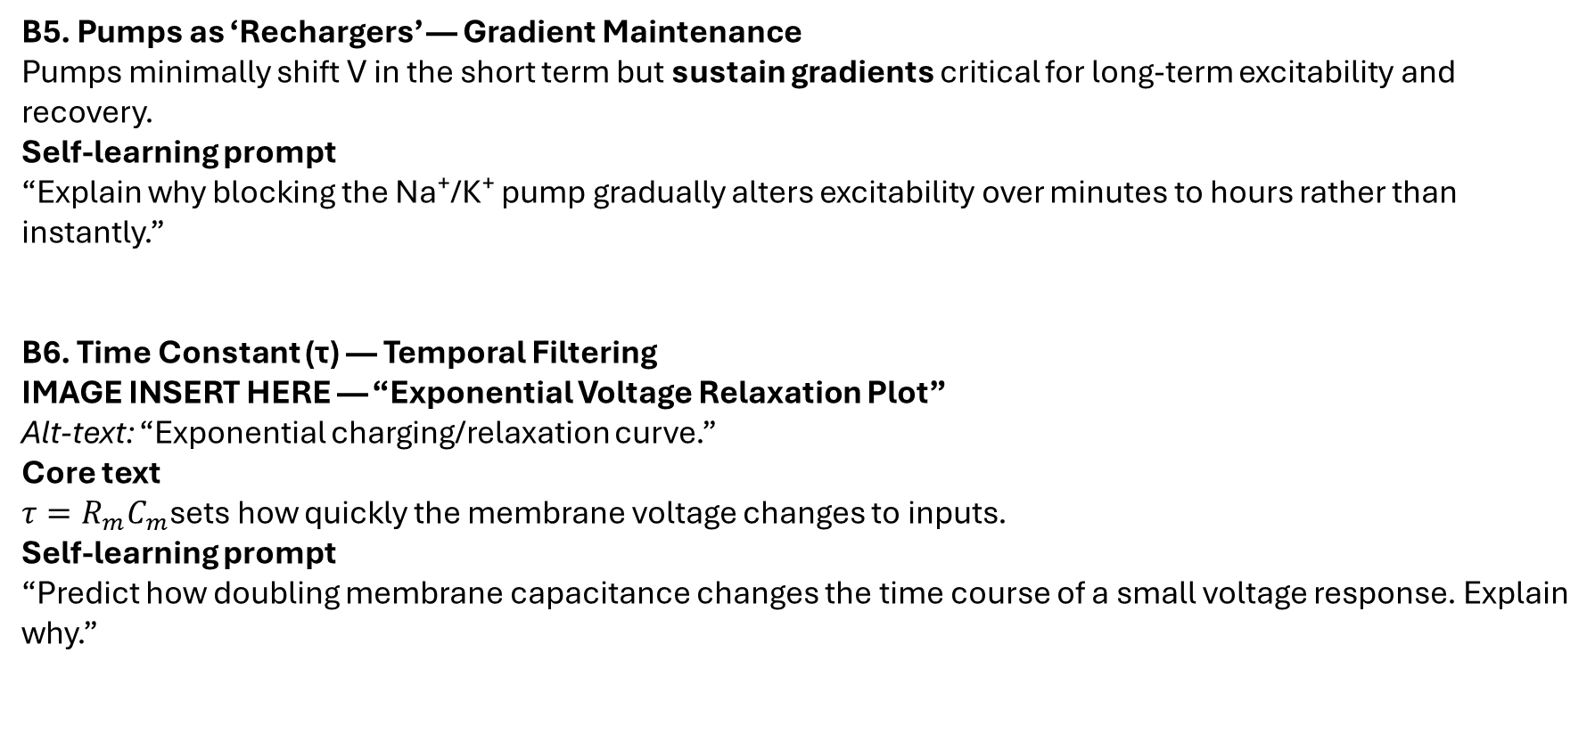
B5. Pumps as ‘Rechargers’ — Gradient Maintenance Pumps minimally shift V in the short term but sustain gradients critical for long‑term excitability and recovery.
Self‑learning prompt “Explain why blocking the Na⁺/K⁺ pump gradually alters excitability over minutes to hours rather than instantly.”
B6. Time Constant (τ) — Temporal Filtering
IMAGE INSERT HERE — “Exponential Voltage Relaxation Plot” Alt‑text: “Exponential charging/relaxation curve.”
Core text $τ=R_{m}C_{m}$sets how quickly the membrane voltage changes to inputs.
Self‑learning prompt “Predict how doubling membrane capacitance changes the time course of a small voltage response. Explain why.”

Slide 5
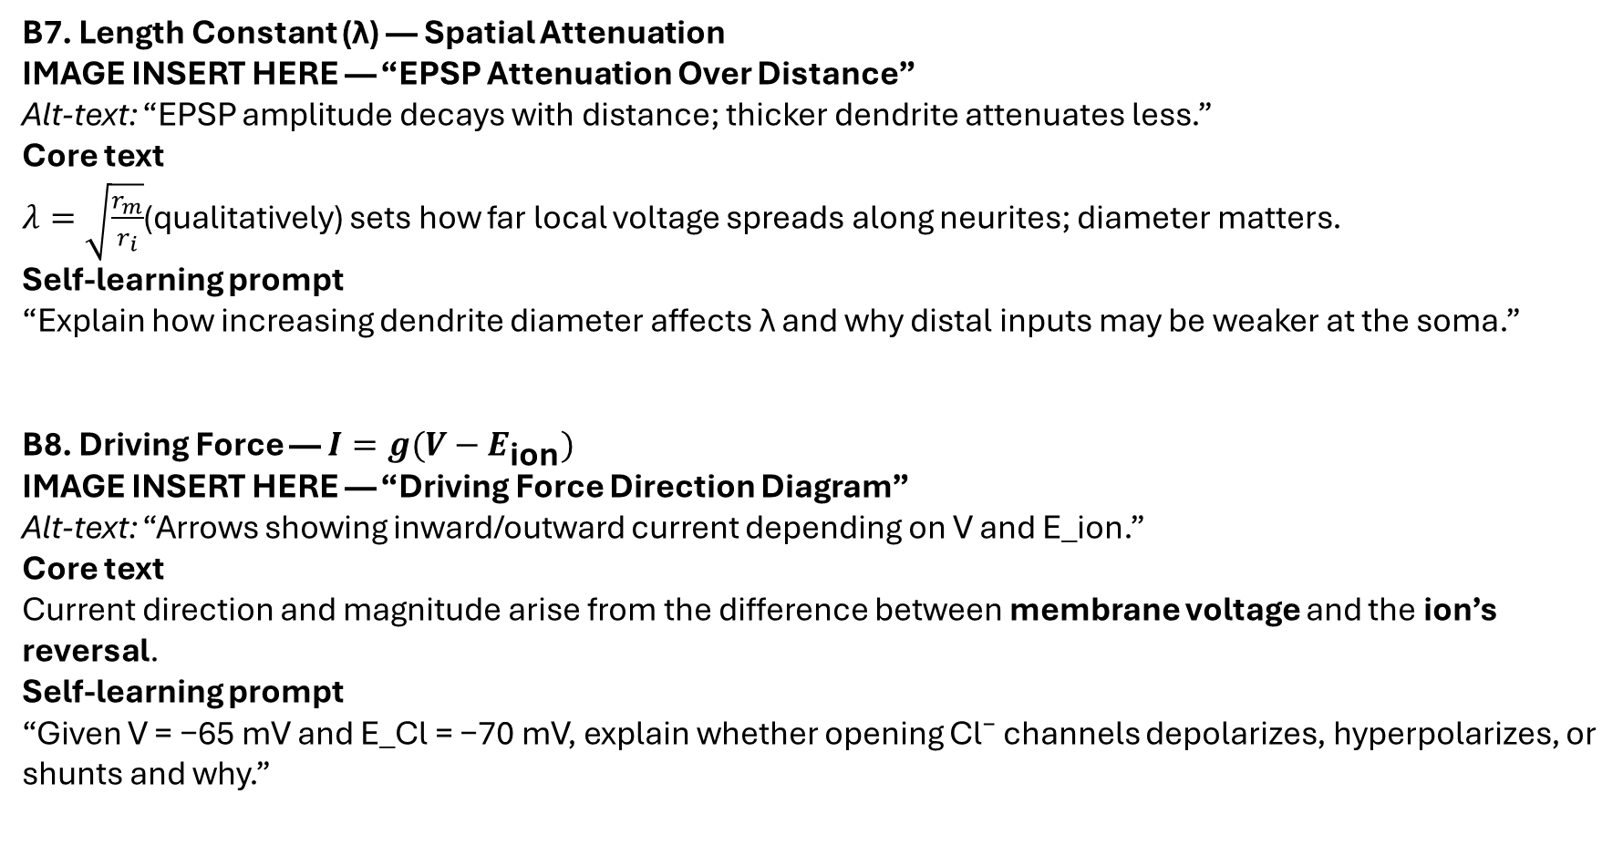
B7. Length Constant (λ) — Spatial Attenuation
IMAGE INSERT HERE — “EPSP Attenuation Over Distance” Alt‑text: “EPSP amplitude decays with distance; thicker dendrite attenuates less.”
Core text $λ=\sqrt{\frac{r_{m}}{r_{i}}}$(qualitatively) sets how far local voltage spreads along neurites; diameter matters.
Self‑learning prompt “Explain how increasing dendrite diameter affects λ and why distal inputs may be weaker at the soma.”
B8. Driving Force — $I=g(V−E_{\text{ion}})$
IMAGE INSERT HERE — “Driving Force Direction Diagram” Alt‑text: “Arrows showing inward/outward current depending on V and E_ion.”
Core text Current direction and magnitude arise from the difference between membrane voltage and the ion’s reversal.
Self‑learning prompt “Given V = −65 mV and E_Cl = −70 mV, explain whether opening Cl⁻ channels depolarizes, hyperpolarizes, or shunts and why.”

Slide 6
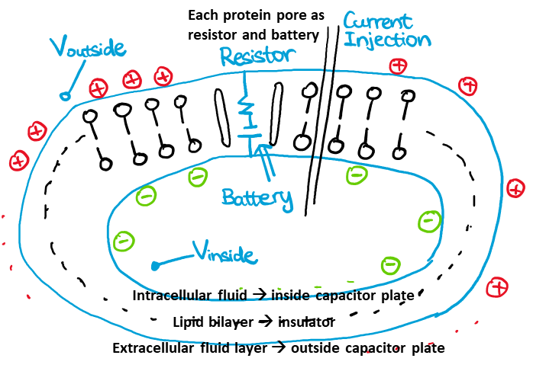
B9. Myelination — Changing Effective Membrane Properties Myelin reduces capacitance and increases resistance in internodes, enabling saltatory conduction between nodes.
Self‑learning prompt “Predict how demyelination affects signal propagation and threshold at nodes.”
B10. Hodgkin–Huxley in a Nutshell — The Membrane Equation The membrane equation combines capacitance, conductances, and driving forces into a time‑evolving voltage description used in simulators like NEURON.
Self‑learning prompt “In 4–6 sentences, map capacitor, conductances, and reversal potentials to biological elements and state the membrane equation qualitatively (no derivation).”

